Slide 1
Automatic Text Summarization
( A Generic Text Summarizer )
DSI10: Guat Hwa

Slide 2
Problem Statement
Too many articles to read but too little time ?
Have a text summarizer that will take in an article as input and return a summary as output.
Problem Type: Unsupervised Learning using Natural Language Processing (NLP)

Slide 3
What is Text Summarization in NLP?
“Automatic text summarization is the task of producing a concise and fluent summary while preserving key information content and overall meaning”

Slide 4
Types of Summarization

Slide 5
Current Approaches on Text Summarization

Slide 6
Generic Text Summarizer’s Features
Input
Upload Text File (.txt, .pdf)
Paste an URL
Paste A block of Text
Specify Summary Size (1/3/5 mins, no. of sentences)
Select Summarization Methods
Output
Summary

Slide 7
Extractive Text Summarization Methods
Model 1: Graph Based Summarization(TextRank)
Model 2: Centroid Based Summarization (Bag-of-Words)
Model 3: Pre-Trained Bert Summarization

Slide 8
Sample Text
West Nile virus (WNV) is the leading cause of mosquito-borne disease in the continental United States. It is most commonly spread to people by the bite of an infected mosquito. Cases of WNV occur during mosquito season, which starts in the summer and continues through fall. There are no vaccines to prevent or medications to treat WNV in people. Fortunately, most people infected with WNV do not feel sick. About 1 in 5 people who are infected develop a fever and other symptoms. About 1 out of 150 infected people develop a serious, sometimes fatal, illness. You can reduce your risk of WNV by using insect repellent and wearing long-sleeved shirts and long pants to prevent mosquito bites.
Number of Sentences: 8
Number of Words : 120

Slide 9
Model 1 Graph Based Summarization (TextRank)

Slide 10
TextRank Algorithm
Sentence
tokenizer
GloVe Word
Embeddings
Text
Sentences
(*cleaning)
Sentence Vectors
Similarity Matrix
Graph
Scoring
Selection
Cosine
Similarity
pagerank
Networkx
# sentence to sentence similarity
GloVe = Global Vectors for Word Representation (Stanford)

Slide 11
Sentence Sentence Vector
GloVe Word
Embeddings
Sentence vector =
Sum(word vectors)
/ len(sentence)

Slide 12
Sentence Similarity Matrix
sentence
sentence

Slide 13
Sentence Similarity Matrix Graph
Vertice -> Sentence
Edge -> Similarility Score

Slide 14
Sentence Scoring (TextRank)
Sentence score = Sum (all edges)
*The more similar a sentence is with the other sentences, the higher the score
0

Slide 15
Sentence Selection (Top_n)
Id
for printing
for selection

Slide 16
Warning: For long text (memory intensive)
Article on CNN
(65 sentences)
*May crash if run out of memory

Slide 17
Model 2 Centroid Based Summarization (Bag-of-Words)

Slide 18
Centroid Based Summarization Algorithm
Text
Sentences
(*cleaning)
Sentence Vectors
(TF-IDF)
Centroid Vector
(keywords in document)
Scoring
Selection
Note. centroid vector is calculated as the sum of word vectors of most important words (these are selected using tf-idf scores)

Slide 19
Word Vectors (TF-IDF)
TF (Term Frequency) – how many times a term appear in a document
IDF (Inverse Document Frequency) – how important a term is.
Sentence
vector
centroid
vector
*sentences containing more keywords similar to those in centroid vector will have higher scores

Slide 20
Word Vectors (TF-IDF)
TF (Term Frequency) – how many times a term appear in a document
IDF (Inverse Document Frequency) – how important a term is.
Example:
Consider a document containing 100 words wherein the word cat appears 3 times.
TF (“cat”) = (3 / 100) = 0.03.
Now, assume we have 10 million documents and the word cat appears in one thousand of these. Then, IDF(“cat”) = log(10,000,000 / 1,000) = 4.
Thus, the TF-IDF score is the product of these quantities: 0.03 * 4 = 0.12.

Slide 21
Sentence Scoring (based on keywords)
Sentence -> Sentence vector (TF-IDF score each sentence)
Scoring based on cosine distance
*sentences containing more keywords similar to those in centroid vector will have higher scores
centroid vector (sum of all TF-IDF scores)

Slide 22
Sentence Selection
# Check Sentence Similarity_threshold
for selection
for printing

Slide 23
Model 3 Pre-Trained Bert Summarization
Released by Google in 2018

Slide 24
Pre-trained Bert Summarization
Bidirectional Encoder Representations for Transformers by Google 2018
Uses HuggingFace Pytorch transformers library
Works by embedding the sentences, follow by clustering algorithm, finding sentences that are closest to the cluster's centroids.
Model : bert-large-uncased 24-layer, 1024-hidden, 16-heads, 340M parameters

Slide 25
Model Evaluation (BBC News Dataset)

Slide 26
BBC News Dataset (Kaggle)

Slide 27
Rouge Metrics
Recall-Oriented Understudy for Gisting Evaluation
ROUGE-1 -> overlap of unigrams
ROUGE-2 -> overlap of bigrams
ROUGE-L -> longest matching sequence of words
Recall = (number of overlapping words) / (total words in reference summary)
Precision = (number of overlapping words) / (total words in generated summary)

Slide 28
Model Performance
Model | Score
1 Graph Based Summarization
2 Centroid Based BOW Summarization
3 Pre-Trained Bert Summarization

Slide 29
Model Evaluation (User Scoring) (which is the best summary?)

Slide 30
User Scoring : 1st Poll (in Slack)
Summary 1 | Summary 2 | Summary 3
3 votes | 0 votes | 10 votes
Observations:
Summary 1: 3rd, 4th sentences are similar
Summary 2: sentences are sorted based on score,
flow is distorted
Summary 3: best among the 3

Slide 31
Model Enhancement
Model 1 (Graph Based Summarization)
Added new parameter similarity threshold & logic to filter out sentences that are highly similar during sentence selection process
For the sample text, similarity threshold was set to 0.90
Model 2 (Centroid Based Summarization)
Sort the sentences by sentence order during sentence selection to preserve the flow

Slide 32
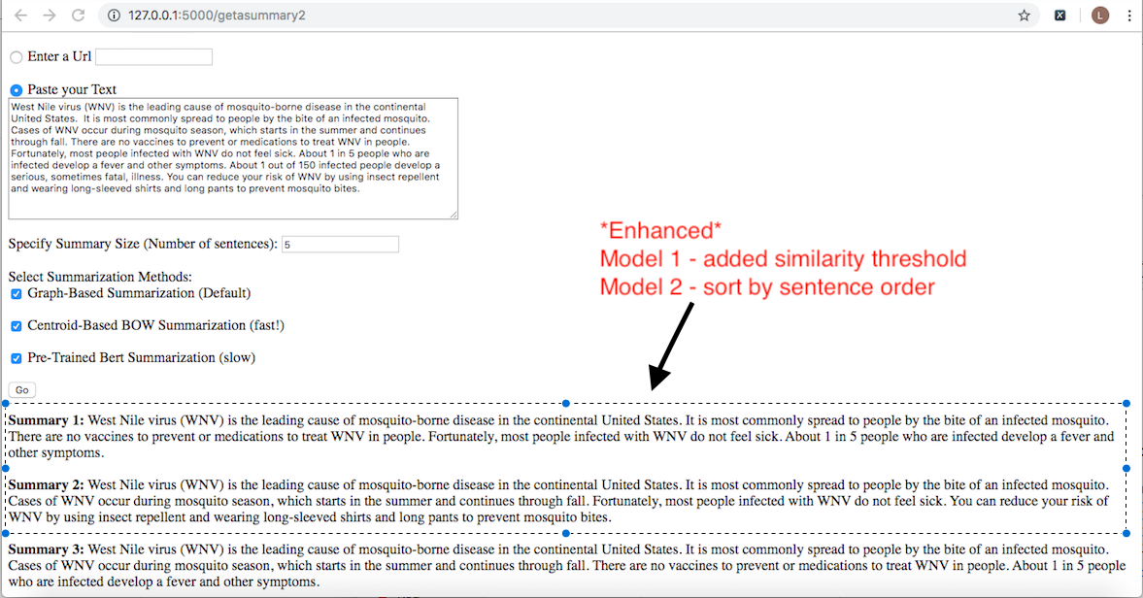
User Scoring : 2nd Poll (in Slack)
Summary 1 | Summary 2 | Summary 3
0 vote | 10 votes | 1 vote

Slide 33
Conclusions
All 3 models appear to generate summaries reasonably well, with model 2 (centroid based BOW summarization) being the best in terms of speed and quality of summary.
This project can be further expanded to include text visualization, multiple document domains, abstractive summarization and deployed on mobile platform.

Slide 34
Demo

Slide 35
Demo (URL)
https://datascience.berkeley.edu/about/what-is-data-science/
https://www.channelnewsasia.com/news/singapore/e-scooter-pmd-16-years-old-pass-theory-test-no-phones-paths-12150670

Slide 36
Anytime
Anyone
No time
To read
Get a Summary
Free
Anywhere
Anytext

